Slide 1

OSNF
LECTURE
Wireless Networks
Operating Systems & Networking Fundamentals
Diploma in CSF/IT
Year 1 (2021/22), Semester 2
Notes:
Left-hand Bar – Replace FSP by your module code and X by the lecture number.
Replace Lecture Title
Replace < Module Name >
Replace Year and Semester if necessary

Slide 2
Objectives
At the end of this lecture, you will be able to:
Have a good understanding of wireless local area networks (WLANs)
Identify the components and network devices deployed in a WLAN
Understand WLAN identification, SSID and accessibility via wireless access point (AP)
Have an introductory knowledge of WLAN security
Compare WLAN standards

Slide 3
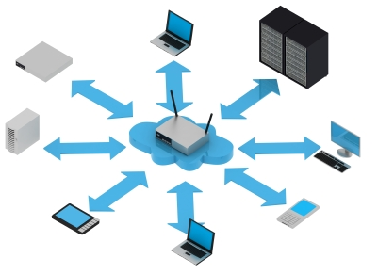

What is a Wireless Network?
A Wireless Network is one where the users access the networks via wireless technology, i.e. without using cable or wire.
A wireless network uses radio frequency (RF) waves, as transmission medium instead of cables.

Slide 4
What is Wireless Network?
Communication across a wireless network is like a two-way radio communication.
Any radio setup has two parts:
The transmitter
The receiver
The transmitter takes the message, encodes it and transmits it with radio waves.
The receiver receives the radio waves and decodes the message.
Both the transmitter and receiver use antennas to radiate and capture the radio signal.

Slide 5
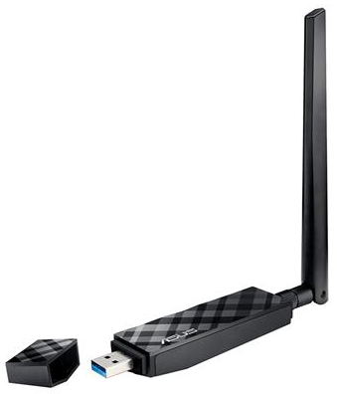
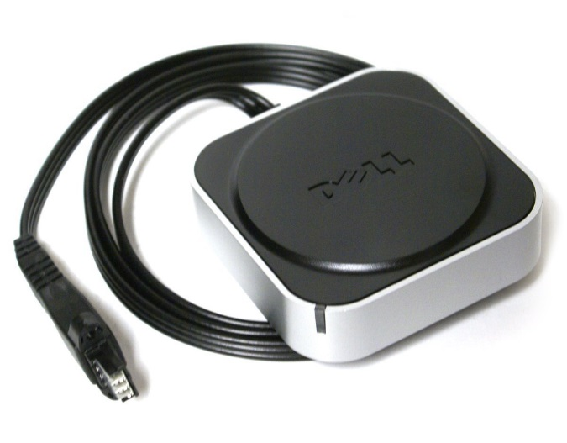

1. Hardware for WLAN – Wireless NIC
The hardware that a PC, laptop or mobile device requires on a wireless network is the Wireless Network Interface Controller (Wireless NIC) component. It may be plugged on motherboard or an external USB adapter.

Slide 6
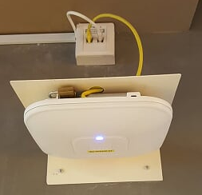

2. Hardware for WLAN – Wireless Access Point
Wireless Access Point features/functionalities
Antennas & RF transmitter/receiver
A RJ-45 wired network interface for connecting to wired network
Power supply
Power-Over-Ethernet (POE) – power supply is from the Ethernet switch
The UTP cable connects the AP to
the switch in the wired LAN
Notes:
Note: Characteristics of an AP is similar to a hub where one device in the WLAN transmits a frame, all the devices receive it.

Slide 7
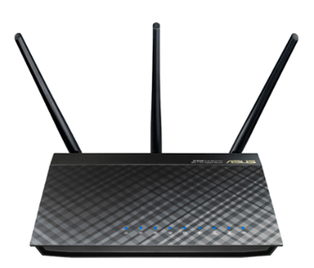
2. Hardware for WLAN – Wireless Access Point
Wireless Access Point features/functionalities
MIMO Multiple-Input Multiple-Output (MIMO) technology is a wireless technology that uses multiple transmitters and receivers to transfer more data at the same time.
All wireless products with 802.11n and above support MIMO
For optimal performance and range, both the mobile device and the access point (AP) needs to support MIMO
Example of a MIMO access point specification is
3x3:2
3 output and 3 input antennas capable of transmitting or receiving 2 separate data streams at the same time

Slide 8
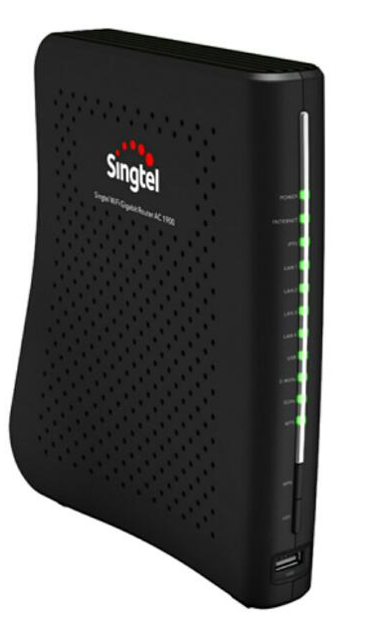
3. Hardware for WLAN – Wireless Router
In most homes, a wireless router (or residential gateway) is used.
It comprises:
Access Point (AP) (with antennas or built-in antennas)
Switch: supports LAN ports for desktops, printers, servers to be attached to it
Router: to provide Internet connectivity through the ISP via an external ONT/modem
Software components/features:
DHCP (Dynamic Host Configuration Protocol)
NAT (Network Address Translation)
Notes:
ONT (optical network terminal)
ONR (optical network router): ONT with router functionality
ISP like Singtel may use an ONR and a separate access point for WiFi

Slide 9
Activity 1
Watch the video on wireless network devices and roaming:
http://www.professormesser.com/network-plus/n10-006/wireless-network-devices/
(watch till 2:47 mins)

Slide 10
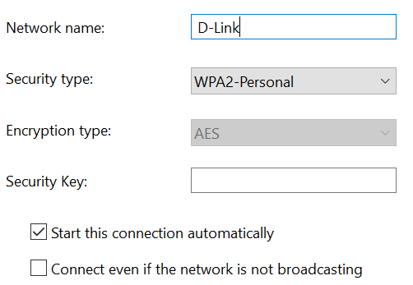
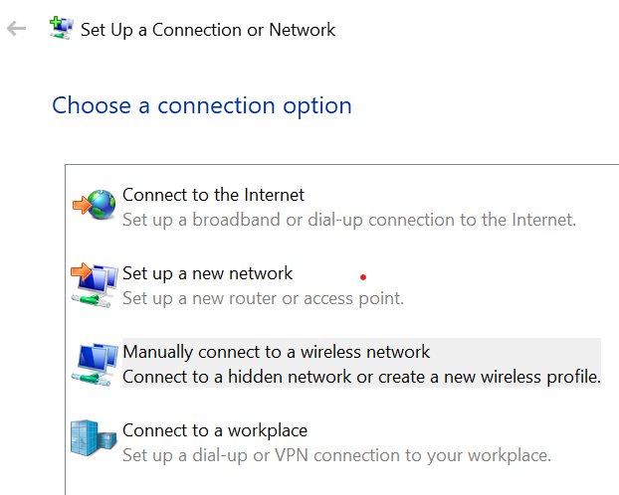
WLAN Configuration
An AP or a wireless router needs to be configured to establish a WLAN. The following parameters are specified unless default settings are used:
SSID (e.g. NPWirelessx, wireless@SG, Linksys, D-Link, etc.)
Frequency channel
Security type (authentication) and Encryption type
Other config: IP address, etc
Notes:
How to Manually Connect to a Wi-Fi Network on Windows 10:
- From the Windows desktop, navigate: Start > Settings icon (lower-left) > Network & Internet > Wi-Fi.Utilize the...
- From the Related settings section, select Network and Sharing Center.
- Select Set up a new connection or network.
- Select Manually connect to a wireless network then select Next

Slide 11
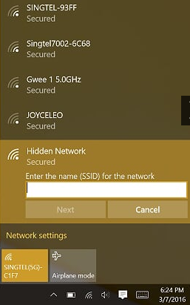
WLAN config: (1) Identification (SSID)
An SSID (service set identifier)- name of a WLAN (what is the SSID of NP’s WLAN?)
SSIDs are case sensitive text strings. The SSID is a sequence of alphanumeric characters (letters or numbers). SSIDs have a maximum length of 32 characters.
An AP is usually set to broadcast its SSID to all wireless devices within its coverage range.
Wireless clients automatically or manually select the SSID of the WLAN to connect.
How do you connect to a WLAN that has SSID broadcast disabled?
Notes:
To connect to a WLAN that has SSID broadcast disabled (security through obscurity), you can:
Look for the Hidden Network and enter the SSID (refer to the screen snapshot on the slide) or
Manually set up a Connection and provide the necessary information: SSID, Security type, Security key (passphrase).

Slide 12
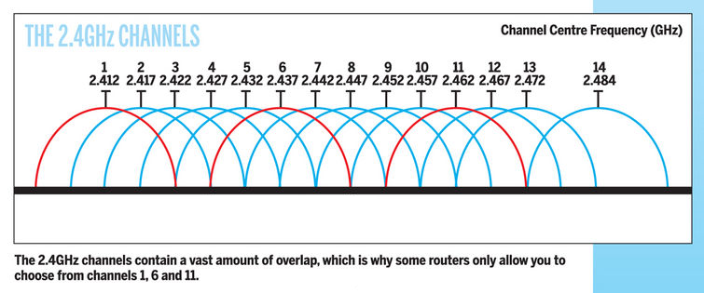
WLAN config: (2) Frequency Channels
WLAN uses a certain radio frequency range, for example, IEEE 802.11n operates on either the 2.4 or 5 GHz bands.
Each band is divided into frequency channels.
A WLAN can utilize one of these channels.
To lessen interference, adjacent WLANs should use different frequency channels.
Notes:
2.4 GHz band – 14 channels (For Singapore use, only channel 1 to 13), only 3 non-overlapping channels (1, 6 and 11)
5 GHz band – 23 non-overlapping channels
Usually the AP will automatically select the best Frequency Channel to use.

Slide 13
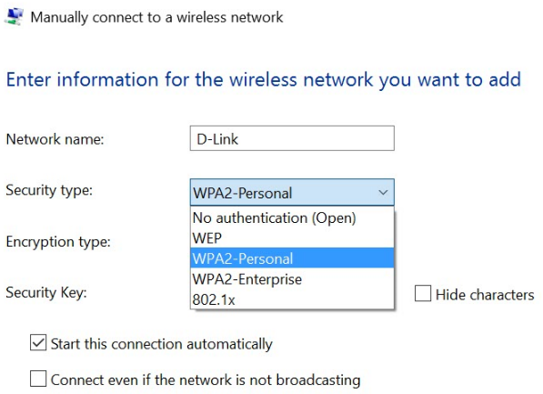
WLAN config: (3) Security Type
Open
No authentication and no encryption; only need to know SSID to connect
2. WEP
(WEP was widely adopted and used since 1999, but it suffered from several critical security issues, became easily cracked)

Slide 14
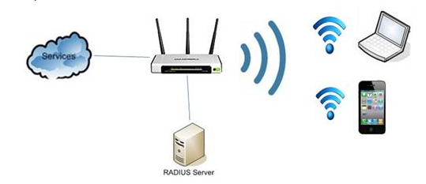
WLAN config: (3) Security Type
WPA2 (stronger encryption, more secured, superseded WEP)
WPA2-Personal or Pre-Shared Key (PSK)
This mode is appropriate for most home and small office networks. When a security key (password) is set on a wireless router or an access point (AP), the same key must be entered by users when connecting to the Wi-Fi network.
WPA2-Enterprise
WPA2-Enterprise provides wireless security in enterprise environments where a remote authentication server (e.g. RADIUS server) is deployed.
Notes:
Wireless router at home: Wi-Fi Protected Access 2 (WPA2) - Personal; user is authenticated using the security key set on the wireless router.
NPWirelessx: WPA2 – Enterprise; user is authenticated by RADIUS server using User ID and password.

Slide 15
Other config (4): IP Address, etc
IP address, subnet mask, gateway
An AP or wireless Router is also an IP host, hence it requires an IP address (to allow administrator to configure the settings over the network)
MAC address filter list
Administrator can specify a list of valid MAC-addresses which
are allowed to join the WLAN – for security purpose.
Notes:
IP address is needed so that you can configure the AP Wireless Settings, LAN Setting and Internet Settings.

Slide 16
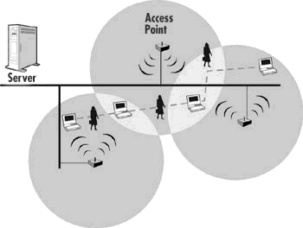
WLAN Roaming
More APs can be added to extend the coverage range of WLAN.
Coverage areas of these APs should overlap
WLAN Roaming is when a wireless client moves from one point to another, it surveys radio frequencies to find an AP that provides a better service (e.g. stronger signal or higher data rate)
A seamless handoff occurs when client associates with the new AP.
The Same SSID, authentication and encryption used on all APs.
Channel frequency should be different for adjacent APs.
Notes:
Basic Service Set (BSS) – only 1 AP. Frequency Channel typically set to “Auto”.
Extended Service Set (ESS) – 2 or more APs. For 2.4GHz frequency band, use channels 1, 6 and 11.

Slide 17
Activity 2
Watch the video on IEEE 802.11 Wireless Standards:
https://www.bing.com/videos/search?q=802.11+wireless+standards+%2b+comptia&&view=detail&mid=FA5C680B97E15F99003CFA5C680B97E15F99003C&&FORM=VRDGAR&ru=%2Fvideos%2Fsearch%3Fq%3D802.11%2Bwireless%2Bstandards%2B%252b%2Bcomptia%26FORM%3DHDRSC4
(6:22 mins)
Fill in the Maximum Speed column in the next slide.

Slide 18
IEEE 802.11 Standards
IEEE 802.11 is a set of media access control (MAC) and physical layer (PHY) specifications for implementing WLAN communication.
IEEE 802.11ac standard was approved in January 2014. It is replacing current WLAN using IEEE 802.11n standard or earlier.
Standard | Frequency Band (GHz) | Maximum Speed (Mbps)
802.11a | 5
802.11b | 2.4
802.11g | 2.4
802.11n | 2.4 or 5
802.11ac | 5
Notes:
For 802.11 g and n, the channels are 20 megahertz wide and have non-overlapping channel at channel one, channel six, and channel 11.
802.11 n can have twice the size of the channel width at 40 megahertz, so you can have the higher speeds.
Typical speed of 802.11ac is 1300 Mbps, which is about 3x faster than the typical 450Mbps of 802.11n.
802.11ac uses 5GHz while 802.11n uses both 5GHz and 2.4GHz.

Slide 19
Wi-Fi Alliance’s Naming System
Wi-Fi 6: 802.11ax (2019)
Wi-Fi 5: 802.11ac (2014)
Wi-Fi 4: 802.11n (2009)
Wi-Fi 3: 802.11g (2003)
Wi-Fi 2: 802.11a (1999)
Wi-Fi 1: 802.11b (1999)

Slide 20
Activity 3
Watch the video on “Wireless Connection Setup with Singtel - Dual-Band Wireless Router”: https://www.youtube.com/watch?v=AZuUu9z0nrY (2:19 mins)

Slide 21
2.4GHz versus 5GHz Frequency Band
Advantages of 5GHz:
Remains relatively interference free while 2.4GHz band is more prone to interference as cordless home phones and microwaves also use this band
Offers much higher speed with the same channel width
Has 23 non-overlapping channels vs. only 3 in the 2.4 GHz band
Disadvantages of 5GHz:
Covers a shorter range than 2.4GHz band (the higher the frequency of a wireless signal, the shorter its range)
Note: Recent 802.11ac devices are able to mitigate this disadvantage by using beamforming feature which focus the signals toward each receiving client device.
Notes:
Source: http://www.speedguide.net/faq/is-5ghz-wireless-better-than-24ghz-340
Notes:
5GHz connectivity is recommended for more bandwidth intensive activities such as video streaming within shorter range.
2.4GHz connectivity is recommended for normal surfing activities within a larger area.
The higher frequency wireless signals of 5GHz networks do not penetrate solid objects nearly as well as 2.4GHz signals, limiting their reach inside buildings with solid walls and floors.

Slide 22
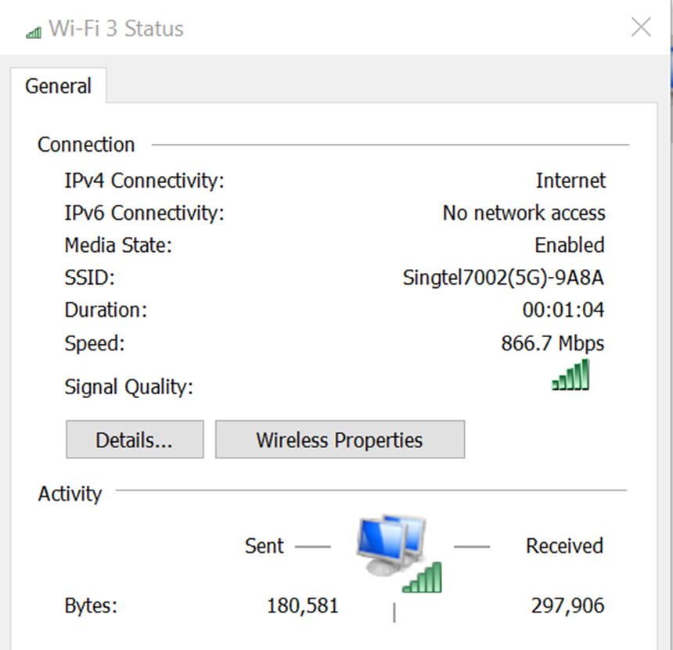
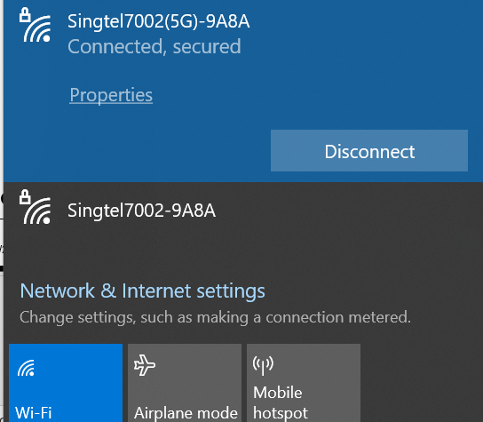
Dual Band Wireless Routers
D-Link DIR-880L Wireless AC1900 Dual Band Gigabit Cloud Router:
1300 Mbps for 5GHz freq band, MIMO (specified by 802.11ac)
600 Mbps for 2.4GHz freq band, MIMO (specified by 802.11n)
Two WLAN SSIDs (5GHz and 2.4GHz)
5GHz Band, 802.11ac connection
Notes:
D-Link DIR-880L Wireless AC1900 is capable of a maximum combined data rate of 1900 Mbps
- 1300 Mbps (3 x 433.3 Mbps) for 5GHz freq band, MIMO 3x3:3 i.e. 3 data streams (specified by 802.11ac)
- 600 Mbps for 2.4GHz freq band, MIMO (specified by 802.11n)
Reference for IEEE 802.11ac Standards: https://en.wikipedia.org/wiki/IEEE_802.11ac

Slide 23
Activity 4
4.1. Check the “Wi-Fi Status” on your notebook to discover:
(a) SSID of WLAN
(b) Speed
4.2. Click on “Wireless Properties” to discover:
(a) Network type
(b) Connection setting
4.3 Click on “Security” tab to discover:
(a) Security type
(b) Encryption type
(c) Security key
Notes:
Optional: Install the Android App: Wi-fi Analyzer to an Android phone and discover and analyse wireless network(s).

Slide 24
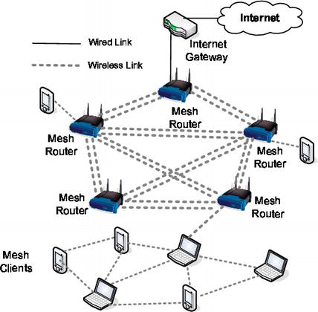
Wireless Mesh Network
IEEE 802.11s standard
Enables wireless devices to interconnect to create a WLAN mesh network

Slide 25
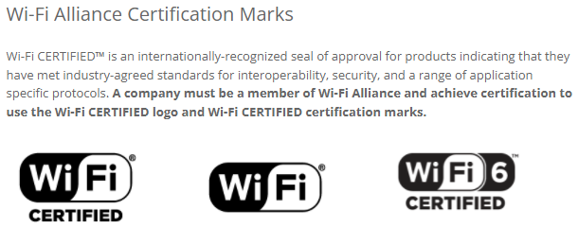
Wi-Fi Alliance Wireless Mesh
Created new standard call Wi-Fi EasyMesh®
Brings interoperability to mesh Wi-Fi hardware

Slide 26
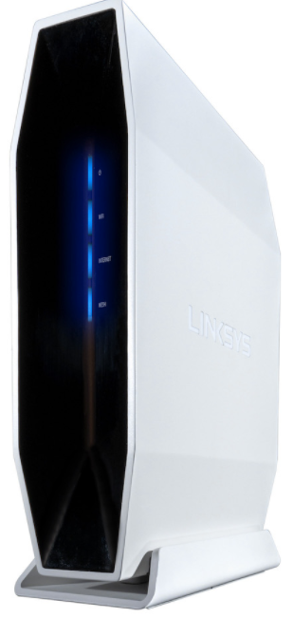
Example of WiFi 6 EasyMesh Router
Linksys E9450 WiFi 6 Router specifications:
EasyMesh support
802.11ax wireless technology
Dual-Band AX5400 router delivers speed of up to 5.4 Gbps
MU-MIMO technology
2x2 + 4x4 Spatial streams (6 streams)
4 gigabit Ethernet ports and one gigabit Internet port
Notes:
WiFi 6 standard was formerly called IEEE 802.11ax
MU-MIMO (multi-user MIMO) technology allows AP to transmit multiple frames to different clients, all at the same time over the same frequency

Slide 27
Summary
We have covered the following:
Definition of wireless networks
Components and network devices deployed in a WLAN
WLAN identification, SSID and accessibility via access point (AP)
WLAN security
Comparison of WLAN standards

